Slide 2
SPFx with React
Siddharth Vaghasia
https://github.com/siddharth-vaghasia

Slide 3







Siddharth Vaghasia
Technical Consultant – M 365, SharePoint, .NET
Speaker | Blogger | PnP Contributor
https://www.siddharthvaghasia.com
https://www.c-sharpcorner.com/members/siddharth-vaghasia
https://github.com/siddharth-vaghasia/
https://sharepoint.stackexchange.com/users/38824/siddharth-vaghasia
siddh.vaghasia@gmail.com
siddharthvaghasia
@siddh_me
siddharth.vaghasia

Slide 4
What is React?
Hello world React JS app
Concepts and Usage
Hands on
Code Walkthrough
Covid-19 Stats WebPart

Slide 5




Component…?? Props? States ??

Slide 6


What is React?
a JavaScript library created by Facebook
for building user interfaces.
declarative, efficient, and flexible
It lets you compose complex UIs from small and isolated
pieces of code called “components”.
NOT a framework
https://develoger.com/is-reactjs-library-or-a-framework-a14786f681a0

Slide 7
React Concepts and Usage
Components
Render method
State
Props
Constructor
Event handlers
Conditional rendering
The map method
Render Prop Technique
Inspired from - https://laurakokkarinen.com/how-to-get-started-with-react-for-building-advanced-spfx-solutions/

Slide 8
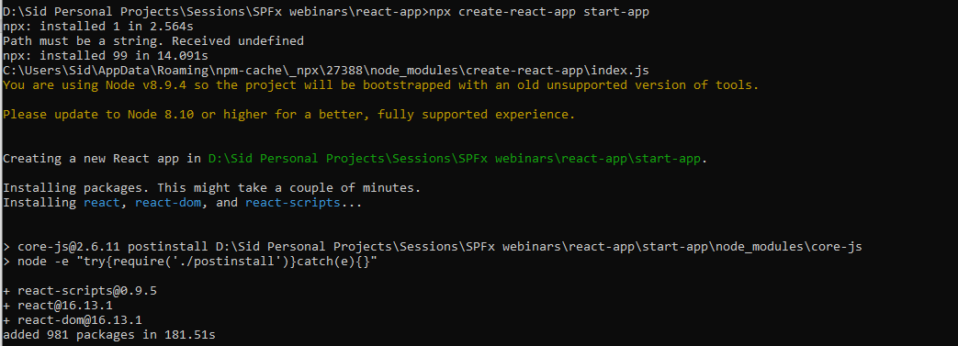
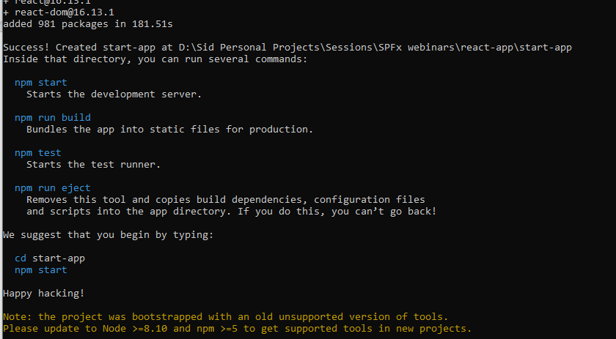
React JS Application
Install React environment
npm install -g create-react-app
Create React app
npx create-react-app start-app
Run application
npm start
Go to Project

Slide 9
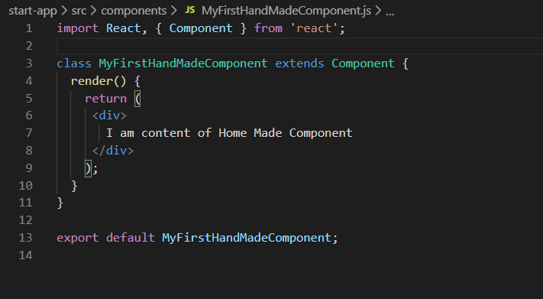
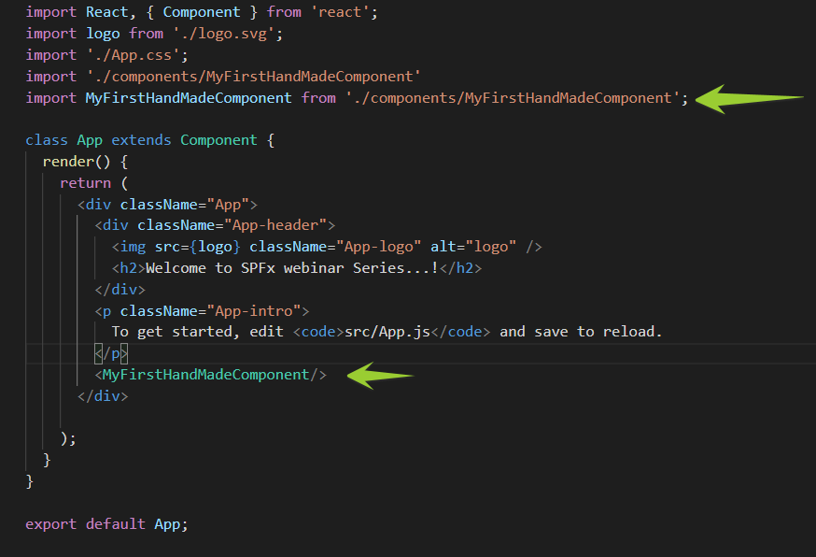
Create a custom component
MyfirstHandmadecomponent.js
App.js

Slide 10

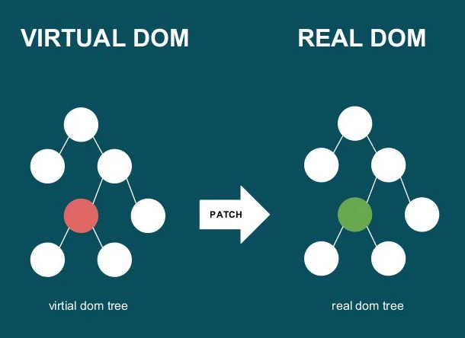
How does React work?
React creates a VIRTUAL DOM in memory.
Instead of manipulating the browser's DOM directly, React updates virtual DOM where it does all the necessary manipulating, before making the changes in the browser DOM.
React only changes what needs to be changed!
React finds out what changes have been made, and changes only what needs to be changed.
https://we-are.bookmyshow.com/at-the-of-react-3636e293e09

Slide 11
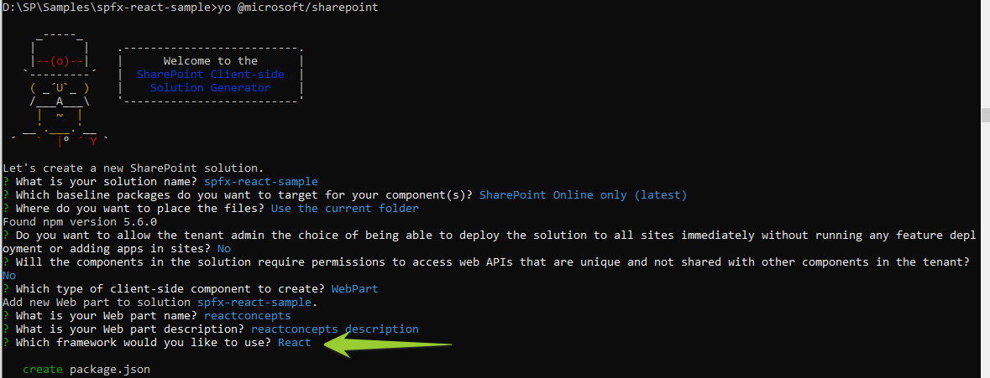
SPFx webpart with React framework
Go to Project

Slide 12
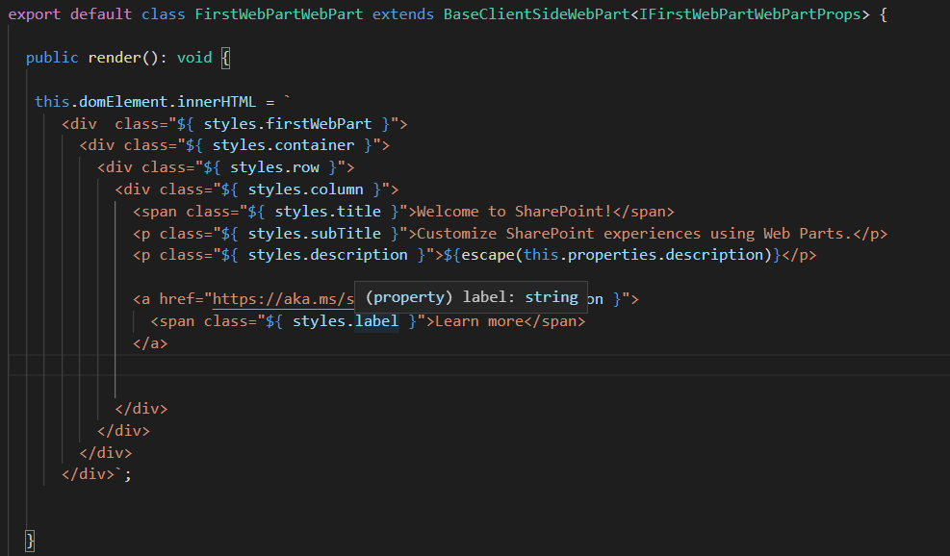
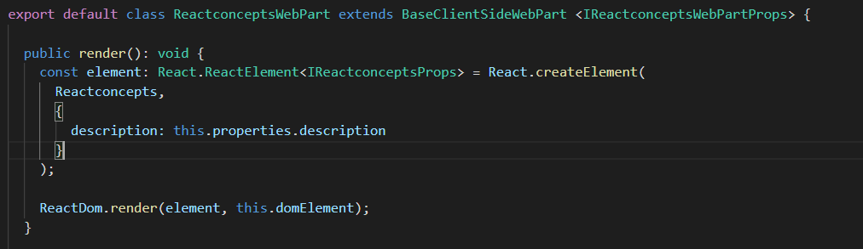
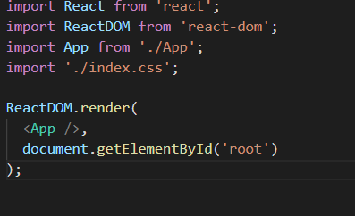
Webpart.ts
No Javascript Framework
Go to Project
React Framework
Go to Project
Index.js(from react stand alone app)

Slide 13
Components
Components are like functions that returns HTML elements.
independent and reusable bits of code
all UI elements, such as buttons, menus, headers, etc., exist as separate components.
Accepts arbitrary inputs(called props) and returns React element what should appear on screen via render method
Components come in two types
Class components
Function components

Slide 14
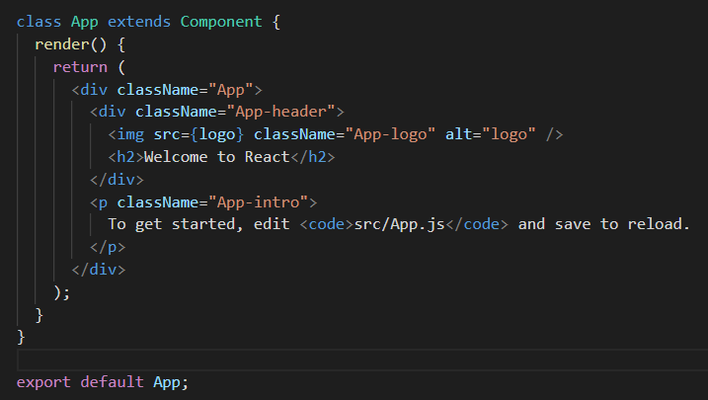
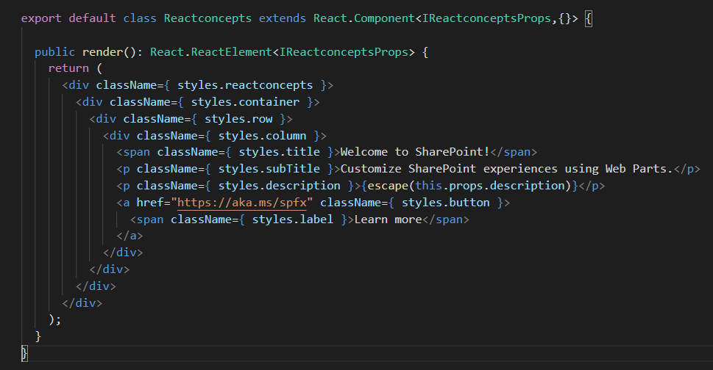
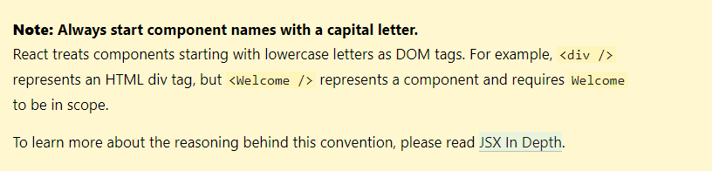
Class Components
Uses OOPs concept
Should extends React.Component
Need to override render method
Should export

Slide 15
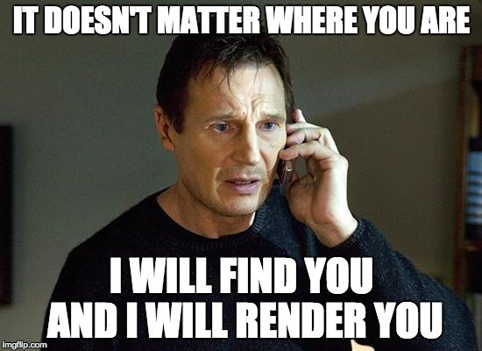
React render method
Render method’s goal is to return HTML.
Its normal function only and it has to return HTML markup or null
This method is called when state is change
using this.setState() method
We should not set state in render method.

Slide 16
Component Lifecycle
componentWillMount
Immediately before initial rendering
componentDidMount
Immediately after initial rendering
componentWillReceiveProps
When components received new props
shouldComponentUpdate
Before rendering, after receiving new props or when state changes
return false to prevent rendering
componentWillUpdate
Before rendering, after receiving new props or when state changes
componentDidUpdate
After component’s updates are send to DOM
componentWillUnMount
Immediately before removing component from DOM

Slide 17
What is JSX?
JSX stands for JavaScript XML.
Its just Syntax which allows to write HTML in React.
To write HTML elements in JavaScript and place them in the DOM without any createElement() and/or appendChild() methods.
JSX converts HTML tags into react elements.

Slide 18
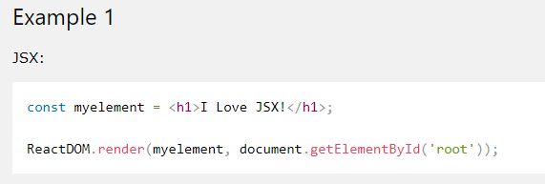
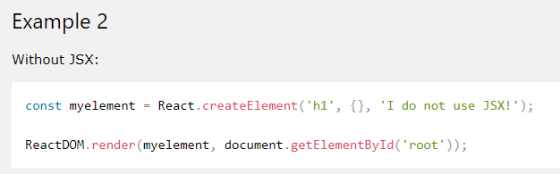
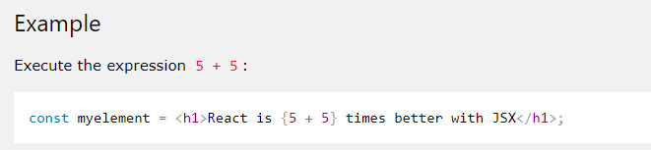
Examples of JSX
Expressions in JSX
With JSX you can write expressions inside curly braces { }.
The expression can be a React variable, or property, or any other
valid JavaScript expression. JSX will execute the expression
and return the result:

Slide 19
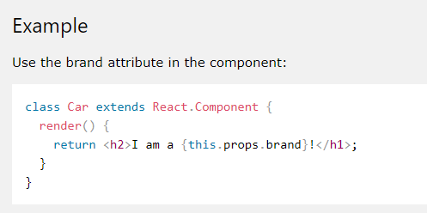
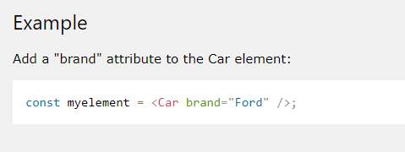
React Props
Props are arguments passed into React components.
Props are passed to components via HTML attributes.
React Props are like function arguments in JavaScript and attributes in HTML.
Props are read only, we can’t change it

Slide 20
React State
React components has a built-in state object
The state object is where you store property
values that belongs to the component.
When the state object changes, the component re-renders.
State is observable. It can hold data that may change over time
State is limited to class components

Slide 21
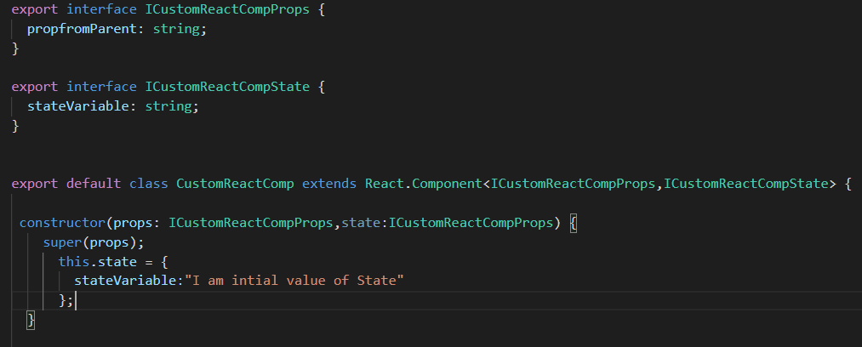
Constructor
Required when using State
Need to call super() method to initiate parent class
Need to initialise all the state object here
Will be only called once.

Slide 22

Event Handlers
React can perform actions based on user events
React has the same events as HTML: click, change, mouseover etc.
In class components, the this keyword is not defined by default, so with regular functions the this keyword represents the object that called the method, which can be the global window object, a HTML button, or whatever.
Method -1 If you must use regular functions instead of arrow functions you have to bind this to the component instance using the bind() method
Method 2 – Use arrow function while calling
Method 3 – Use arrow function while defining function

Slide 23

Class Variables
We can use private/public variables.
This can be used when we don’t want to
call render method when something changes.

Slide 24

Conditional Rendering
Why? - Show/hide, Toggling application functionality
How? - Use state for conditional rendering
Don’t - Use Traditional way…
https://scotch.io/tutorials/7-ways-to-implement-conditional-rendering-in-react-applications

Slide 25
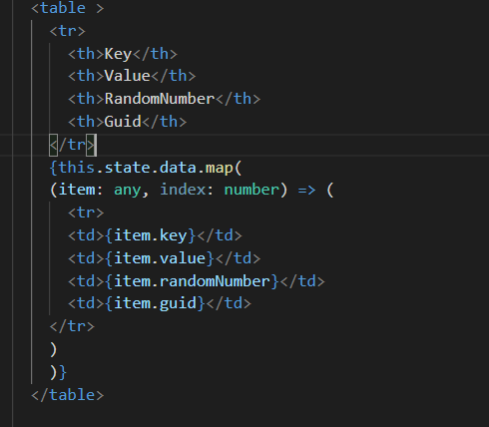
The famous map method
Just another loop
map calls a provided callback function once for each element in an array
callback is invoked with three arguments: the value of the element, the index of the element, and the array object being mapped.
https://developer.mozilla.org/en-US/docs/Web/JavaScript/Reference/Global_Objects/Array/map

Slide 26
Render Prop Technique
Way to call method/event of parent component/class.
Can be used when you want to do something on parent component based on event from child component.
technique for sharing code between React components using a prop whose value is a function.
Share the state or behaviour that one component encapsulates to other components that need that same state.
Widely used to override default render method of you components (in Office UI fabric and PnP controls)

Slide 27
Quick takeaways
One component can be called from another component
We can pass data between components via props
Props can be of any type as simple as boolean, string, number or an object or array of object or even function…
Use state when you want to re-render your component based once need to change something.
Use local variables to hold data for your component when you don’t want to re-render component

Slide 28
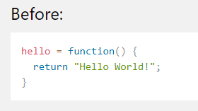
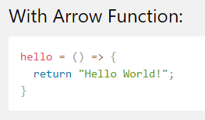
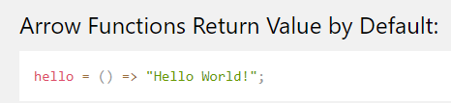
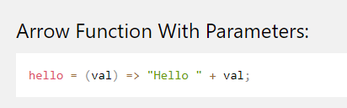
Basics of ECMA Script 6.
Classes – We all know it
Arrow Functions
https://www.w3schools.com/REACT/react_es6.asp

Slide 29
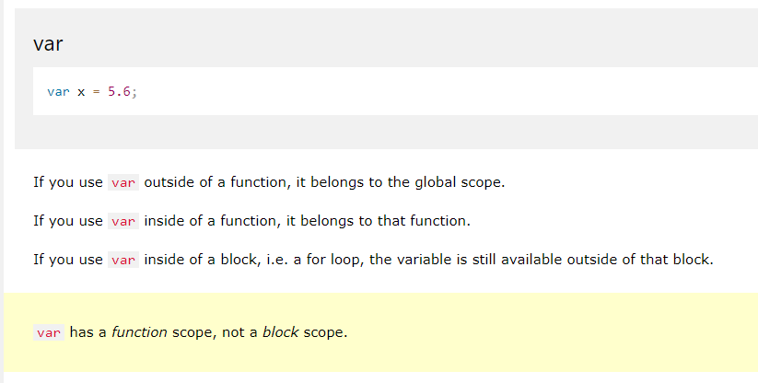
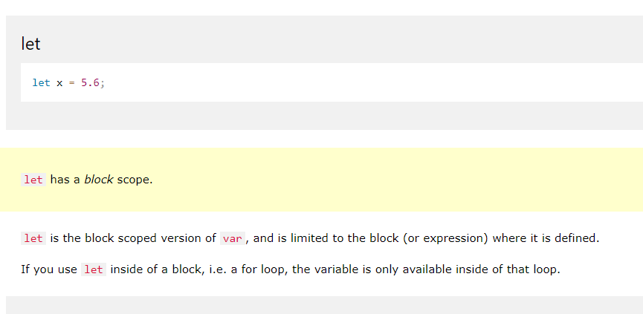
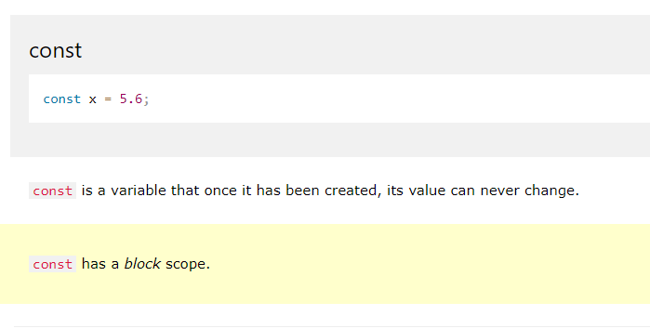
Variables (let, const, var)

Slide 30
Covid -19 Stats Webpart
Code Walkthrough
Go to Project
https://github.com/siddharth-vaghasia/spfx-covid-stats/

Slide 32
Getting started witn PnP
By Harsha Vardhini on 25th April 2020 6 to 7 PM IST

